Slide 1

3-Year Club Planning
For Action, Impact and Growth

Slide 2

WHY: 3-Year Planning
Not too short (annual plan)
Not too long (5-year plan)
Offers balance (both flexibility & forward thinking)

Slide 3

North American Survey (2023)
~350 clubs that showed consistent growth
between 2018-2023
Top ~4% of ~8,200 clubs
121 responded (35%)

Slide 4

SURVEY RESULTS
Growing Clubs take Actions aligned with Rotary’s Action Plan
Set and Track Goals (All)
Strong Leadership Succession (Impact, Adapt)
Partner with Others (Impact, Reach)
Participate in Rotary Grants (Impact)
Use Multiple Media to tell their story (Reach)
…

Slide 5

The Lasso Way
A Few Key Principles
Have a Clear Vision & Purpose (aligning with Rotary’s Action Plan)
Cooperation and Teamwork
Empathy
Effective Communication
Continuous Growth and Learning

Slide 6

Rotary’s 3-Year Annual Goals
Planning (Adapt)
  Build a 3-Year Rolling Action Plan
Membership (Reach)
  Active Members as of June 30
Service (Engagement)
  Members Involved in Service Projects
Rotary Foundation Giving (Impact)
  Annual Fund Contributions
  Polio Plus Contributions
  New Benefactors (Endowment)
Notes:
And just 25 percent of people surveyed said they knew someone in Rotary. All of us here know how this is playing out in real life. Membership has dropped as much as 18 percent in North America and elsewhere. We set a record in 2018 for the number of people who left Rotary.

Slide 7
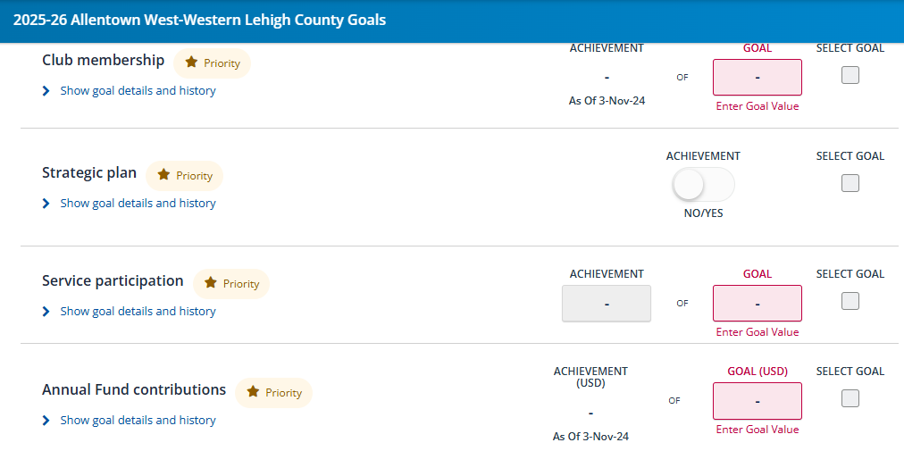
Rotary Club Central Goal Setting Tool

Slide 8
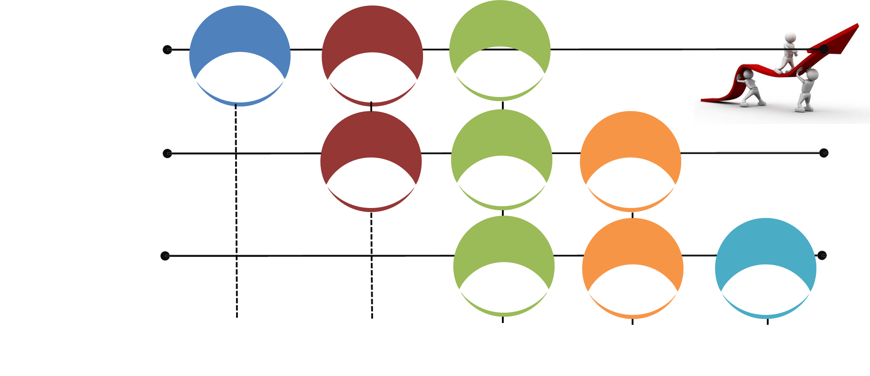
3-year “Rolling” Goals

Slide 9

Table Exercise 1
(7 minutes)
What Key Goals Have Been Effective for Your Club?

Slide 10


The How:
Steps to Building a Club Action Plan
Notes:
This Action Plan is ambitious but achievable, with a five-year time frame that will push us but not exhaust us. It’s focused and to-the-point — like you.

Slide 11



Why Plan?

Slide 12
Steps to Building a Club Action Plan
Get Buy-in
Ask
  Club members
  Your Community
Analyze results
  “SWOT” Analysis
Identify Actions and Set Goals
  “SMART” Goals
Implement, Evaluate and Adjust as Needed
Keep Members
Involved
Throughout
Process

Slide 13
Step 1
“Get Buy In”
Review Proposed Process with Your Board
Talk with your Club Members
Involve Experienced “Planners” in Process
“Cooperation & Teamwork”
“Effective Communication”
Notes:
And just 25 percent of people surveyed said they knew someone in Rotary. All of us here know how this is playing out in real life. Membership has dropped as much as 18 percent in North America and elsewhere. We set a record in 2018 for the number of people who left Rotary.

Slide 14
Step 2
“Ask”
Survey Your Members – Hold a Club Assembly, email those absent
Perform a Community Assessment - or use a one from another community organization
“Empathy”
Notes:
This Action Plan is ambitious but achievable, with a five-year time frame that will push us but not exhaust us. It’s focused and to-the-point — like you.

Slide 15
Club Survey Options (Available at MAPETS.org under Resources)
Club Action Plan Self Assessment
Rotary Club Health Check
Rotary Member Satisfaction Survey
RLI Part 3 SPA 2
Build your Own Survey
Notes:
This Action Plan is ambitious but achievable, with a five-year time frame that will push us but not exhaust us. It’s focused and to-the-point — like you.

Slide 16
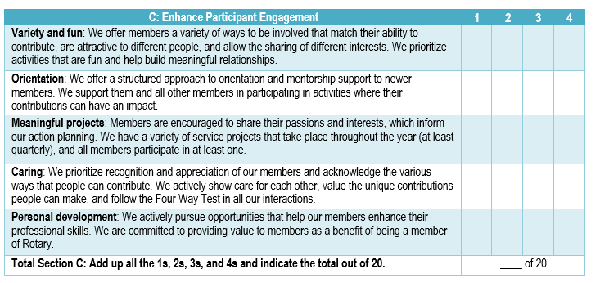
Example - Club Action Plan
Self-Assessment
Notes:
This Action Plan is ambitious but achievable, with a five-year time frame that will push us but not exhaust us. It’s focused and to-the-point — like you.

Slide 17
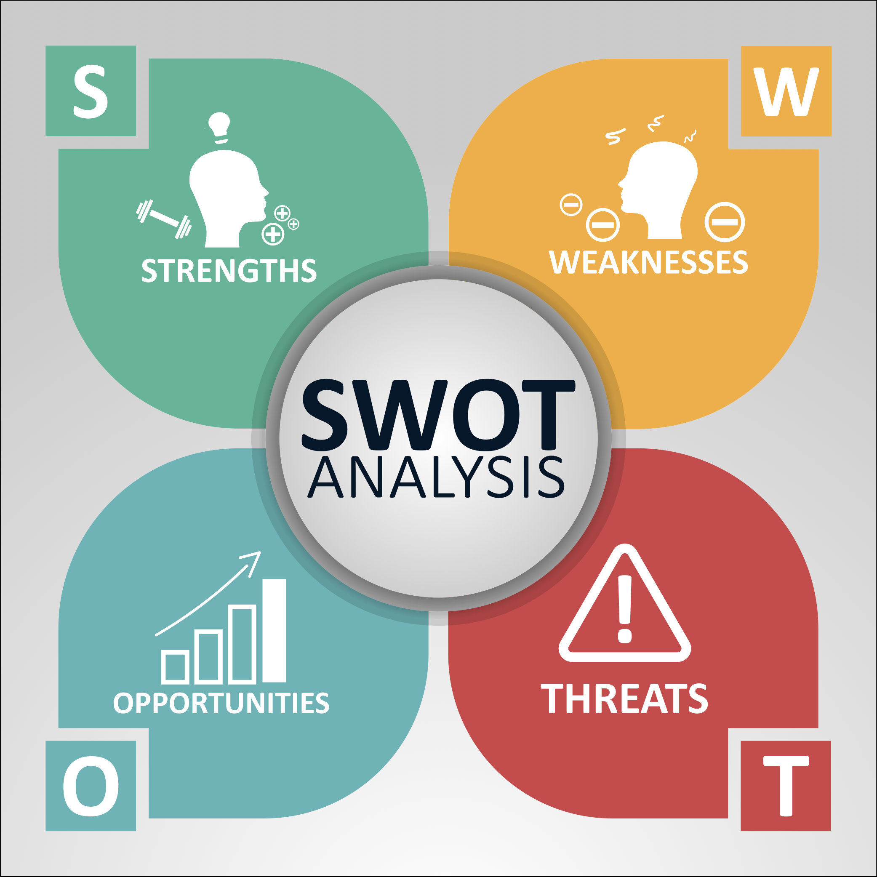
Step 3
Analyze Results
Involve a Core team with diverse backgrounds
Perform “SWOT” Analysis
Utilize outside facilitator if possible
“Cooperation & Teamwork”
Notes:
It has four priorities. Four. Each priority reflects the input, feedback, and hopes of current and former members, leadership, Rotaractors, alumni, Youth Exchange students, and Rotary staff. In all, we reached out to more than a million people who are connected to Rotary in some way to ensure that our Action Plan priorities are the right ones, and are authentically Rotary. The four priorities are:

Slide 18

Step 4
“Identify Actions and Set Goals”
Set “SMART” Goals
  Set a Few Key Goals
  Include Rotary’s 3-Year Priority Goals
Break down goals into Actionable steps
  Assign clear responsibilities and deadlines
“Clear Vision and Goals”
Notes:
And just 25 percent of people surveyed said they knew someone in Rotary. All of us here know how this is playing out in real life. Membership has dropped as much as 18 percent in North America and elsewhere. We set a record in 2018 for the number of people who left Rotary.

Slide 19
Rotary’s 3-Year
Annual Priority Goals
Membership (Reach)
  Active Members as of June 30
Service (Engagement)
  Members Involved in Service Projects
Rotary Foundation Giving (Impact)
  Annual Fund Contributions
  Polio Plus Contributions
  New Benefactors (Endowment)
Notes:
And just 25 percent of people surveyed said they knew someone in Rotary. All of us here know how this is playing out in real life. Membership has dropped as much as 18 percent in North America and elsewhere. We set a record in 2018 for the number of people who left Rotary.

Slide 20
Table Exercise 2
(7 minutes)
Discuss and Document Ideas on building an Action Plan for your club

Slide 21
Step 5
Implement, Evaluate & Adjust as Needed
Ongoing
  Monitor and communicate progress
  Make any adjustments as needed
Every Year
  Review and update goals
  Make any adjustments as needed
“Effective Communication”
“Continuous Growth & Learning”
Notes:
And just 25 percent of people surveyed said they knew someone in Rotary. All of us here know how this is playing out in real life. Membership has dropped as much as 18 percent in North America and elsewhere. We set a record in 2018 for the number of people who left Rotary.

Slide 22
Case Study
“Barre, VT Rotary Club”
Why?
  Last plan done in 2014
  Needed direction for the club
  Needed to energize & engage new members
Notes:
This Action Plan is ambitious but achievable, with a five-year time frame that will push us but not exhaust us. It’s focused and to-the-point — like you.

Slide 23
Case Study
“Barre, VT Rotary Club”
How? (Done over 4 months)
  Created 3 Person Committee
  Used Rotary Club Health Check
  Identified 2 or 3 key elements in focus area (e.g., club experience, service, …)
  Built a summary plan for each focus area and got feedback from club members
  When completed, went through entire draft plan with club for final feedback
Notes:
This Action Plan is ambitious but achievable, with a five-year time frame that will push us but not exhaust us. It’s focused and to-the-point — like you.

Slide 24
Steps to Building a Club Action Plan
Get Buy-in
Ask
  Club members
  Your Community
Analyze results
  “SWOT” Analysis
Identify Actions and Set Goals
  “SMART” Goals
Implement, Evaluate and Adjust as Needed
Keep Members
Involved
Throughout
Process

Slide 25
THANK YOU!

Slide 26
ROTARY’S VISION STATEMENT
TOGETHER WE SEE A WORLD
WHERE PEOPLE UNITE AND TAKE ACTION
TO CREATE LASTING
CHANGE ACROSS THE GLOBE
IN OUR COMMUNITIES AND IN OURSELVES

