Slide 1
LEADING CHANGE
Rotary’s Model for Success
MAPETS Encore Presidents
February 2025

Slide 2
INNOVATION IS CRUCIAL TO ROTARY’S FUTURE
Notes:
Innovation is crucial to Rotary’s future. To embrace and successfully implement new ideas and new initiatives or to improve existing ones, leaders need to manage change. Rotary has developed a change model to help people through change at home, at work, or in a club. Sustainable change is possible only when the people who are affected support the vision for change and modify how they think and behave according to that vision.

Slide 3
subhead
As rotary evolves and grows
as an organization,
embracing innovation is more important than ever.
Notes:
Ways that clubs can embrace change include creating a new club, using hybrid club model to offer an online meeting option in additional to meeting in-person, or beginning a satellite club or e-club.

Slide 4
ROTARY
MUST
CHANGE!
Notes:
Why must Rotary change?
Declining membership
Aging membership
Membership does not reflect communities we serve
Difficulty attracting members who stay
As membership declines, the service we can do declines
KEY POINT:
Rotary must evolve to address new global challenges, attract a diverse membership, embrace modern technology, stay relevant to societal norms, enhance its effectiveness, and become more impactful in its service efforts.

Slide 5
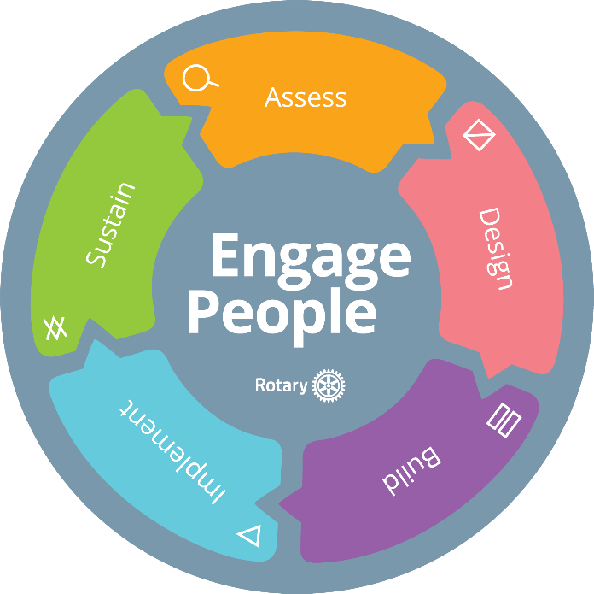
subhead
ROTARY’S CHANGE MODEL is people-centered including how to succeed in leading it, engaging people in the process, planning for change, and responding to resistance.
Notes:
REVIEW – Assess, Design, Build, Implement, Sustain (handout)
Why do you think “engage people” is at the center of the change model?
How can this change model support innovation in Rotary?
KEY POINT: Change initiatives are most successful when change leaders carefully consider the realities and opportunities that face the community and when they support the people who are affected by the change. Leaders should gain others’ commitment to the vision of the change, outline clear and measurable goals for the change, demonstrate a positive attitude toward change, and earn the trust of participants.

Slide 6

ENGAGING PEOPLE
3 KEY ACTIONS
Commitment
Communication
Coaching
Notes:
To engage people in change, secure their commitment, provide clear communication, and offer empathetic coaching.
Commitment
A key component of leading change is gaining acceptance and support from people who will be affected. Although not everyone will understand and support a new initiative right away, leaders can often get more support by assembling a small and dedicated group of people who have influence among others. These people will become the change team and will help develop and implement the plan.
Leaders need to work to secure people's commitment before a change, while it's being implemented, and afterward, but doing so is most important early in the process. If leaders don't get support at the start, the initiative may encounter more resistance, which can disrupt it, delay it, or even jeopardize its success.
How to gain people's commitment:
Make sure people understand the current situation.
Clearly explain what problem is being solved, why this particular solution was selected, and what will be considered a success.
Choose people who are well respected to raise others' awareness.
Communication
Throughout the process, leaders need to give the people who will be affected relevant information at the right time. This means thinking about your audience and what information they need. For example, too much detail early on might overwhelm people, while learning about an issue that affects them late in the process can make people feel like telling them was an afterthought.
Communicating effectively means that people receive useful information, have time to make sense of it, and have ways to give feedback to those making the decisions. Consider using a variety of communication methods to align with different learning styles, such as in-person or virtual meetings, newsletters, emails, posters, events, and recorded messages.
When people don't receive complete and timely information, they're more likely to fill those gaps with false assumptions that could diminish the success of your initiative. Counter this by communicating often and openly and according to your communication plan. Developing this plan is a crucial part of implementing a successful change.
How to communicate well:
Communicate in ways and at times that are appropriate for the audience and meet its needs. For small changes, one announcement might suffice. For more significant changes, communicate more frequently and consider using different methods for specific audiences.
Be as open and accurate as possible in your messages. Catching any errors before you send a message saves time and effort and prevents miscommunication.
Keep your messages succinct. Too much information or irrelevant filler can overwhelm people, frustrate them, or lose their interest.
Coaching
Leaders need to be aware of people's reactions, both positive and negative, to the new initiative. Be prepared to coach others through a range of feelings.
How to coach people through change:
Share updates with those who will be involved and make sure people know who can answer their questions and how to offer feedback.
Give people chances to practice new processes or new skills, and offer opportunities that fit different learning styles.
Offer positive feedback and recognition as people meet milestones.
Learn how to respond to resistance, which we'll discuss more in a later lesson.
Our change model was developed with Rotary's distinct characteristics in mind.
Rotary members often need to implement changes: both smaller, tactical ones and broader, strategic ones. This change model offers everyone in Rotary a framework to guide their approach, specifics about the process they can follow, and tools they can use to implement change successfully.
When we use this model throughout Rotary, we're all approaching change the same way and working together to build a more collaborative and sustainable organization that can have a larger impact.

Slide 7

MANAGING RESISTANCE
Resistance is a natural reaction to change, so leaders should expect it and plan for it.
Notes:
What are some of the reasons people resist change in Rotary?
Resistance is a natural reaction to change, so leaders should expect it and plan for it. An effective leader anticipates what parts of the initiative might face resistance, works to identify what's causing any hesitance, and addresses it in ways that remove or reduce the obstacles. Change within an organization can be difficult, but it can also be exciting for people to learn and discover new skills.

Slide 8
Case study

Slide 9
"This is a changing world; we must be prepared to change with it."
Paul Harris

Slide 10
QUESTIONS

