Slide 1
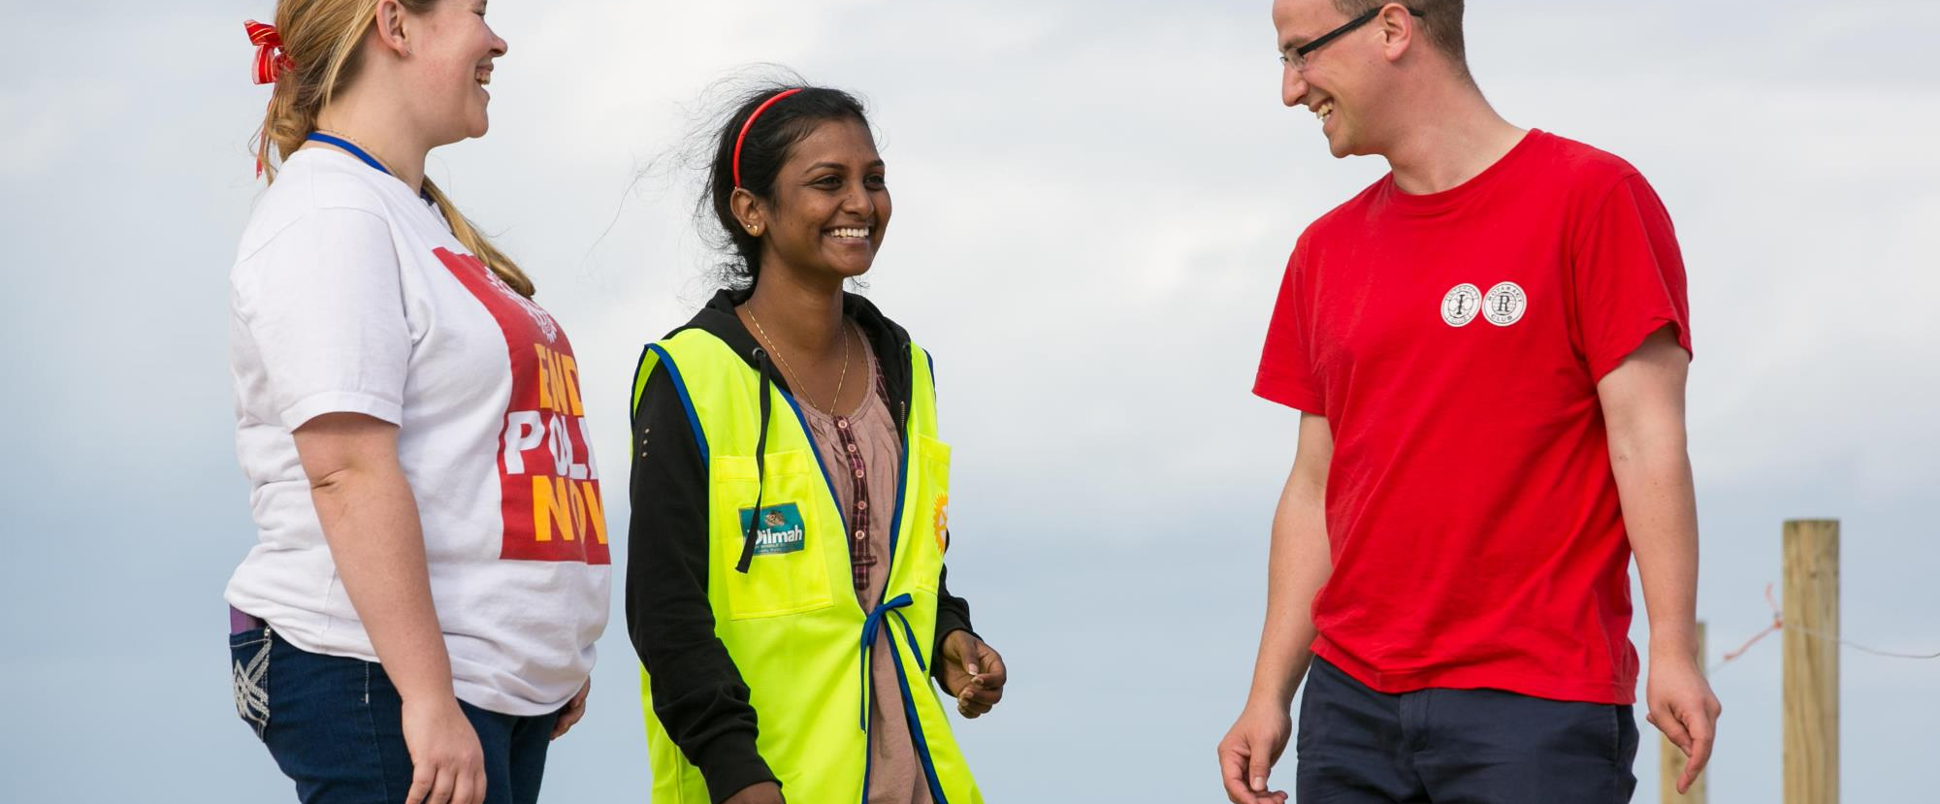
Rotary Resources for
an Awesome Year!

Slide 2
  Club and District Support
  Membership Development
  Grants
  The Rotary Foundation
Your Rotary staff team is here to help

Slide 3
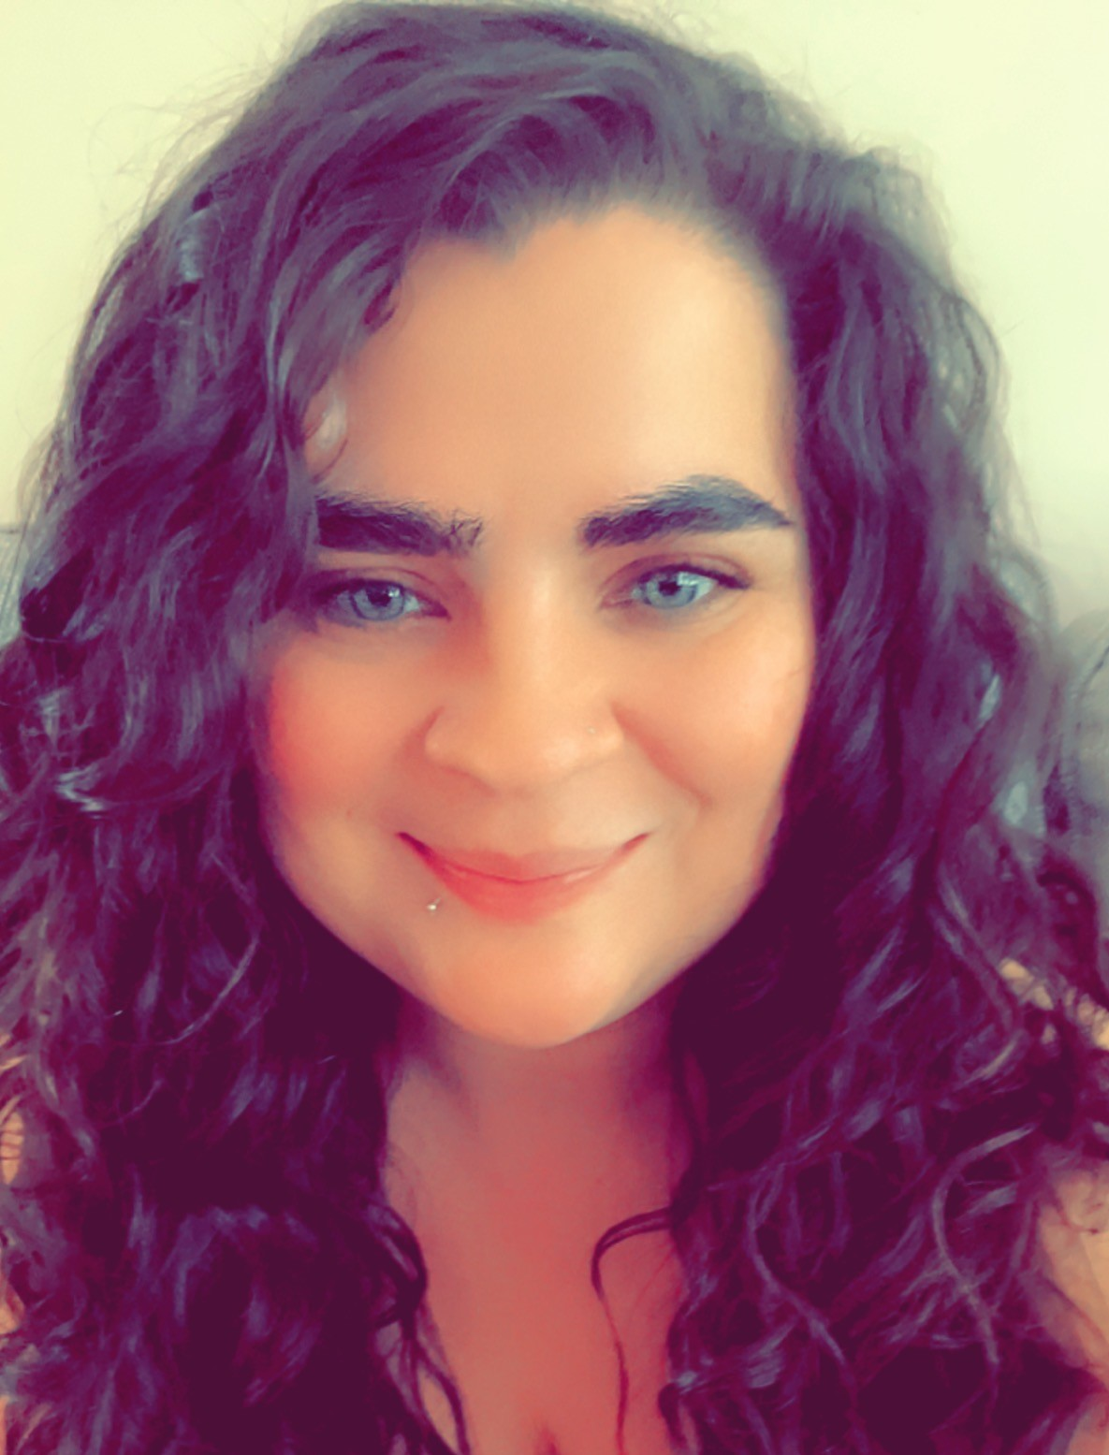

MALLORY ORI
CLUB AND DISTRICT SUPPORT
AMERICAS
HOW WE WORK TOGETHER
Policy and Procedure
Through navigating Rotary International’s constitutional and governance documents, we help you form a better understanding of Rotary.
Club and District Processes
Whether you are chartering a new club, adding a satellite club, or updating your club bylaws, we help keep you up to date!
Advising and Learning
We incorporate creative and strategic planning with zones, districts, and clubs on how to create a more inclusive experience at the various trainings we attend throughout the year.
Associate Officer
Mallory.Ori@rotary.org
+1.847.424.5241
Notes:
The most important way that Mallory can help clubs is by helping locate policy and procedure for situations that may arise in a club or district. If you are uncertain about what policy may apply or what steps a club needs to take for certain issues, Mallory is your number one resource.

Slide 4
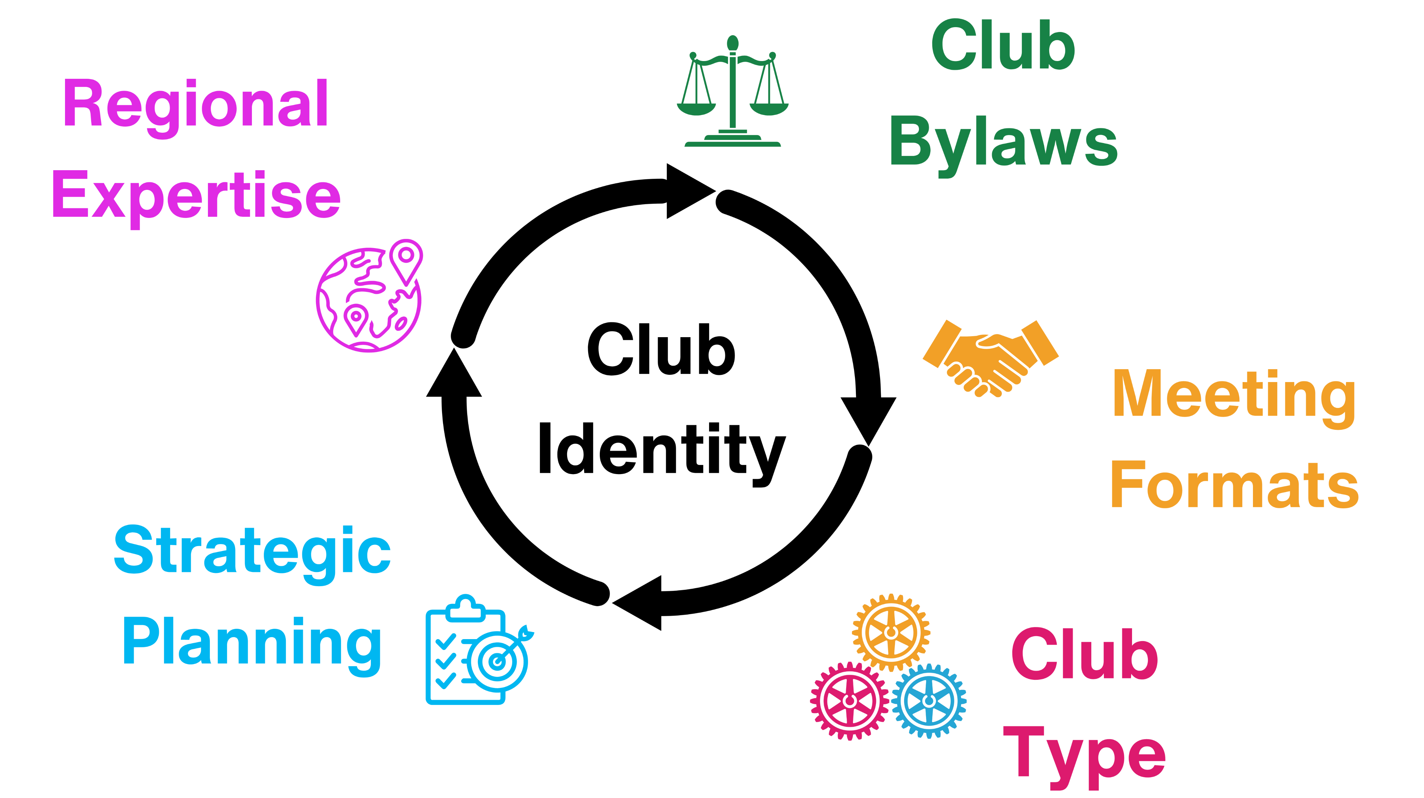
Notes:
Regional expertise: Mallory works with zone 32 and is knowledgeable about what is happening in districts throughout the zone
Club Bylaws: When was the last time your club updated its bylaws? If it has been a while, or the club is currently in the process of reviewing them, Mallory can help make sure they are in line with other RI governance documents.
Meeting Formats and Club Type: Help discuss options for flexibility and growing rotary
Strategic Planning: help clubs fit their goals into RI’s strategic plan.

Slide 5
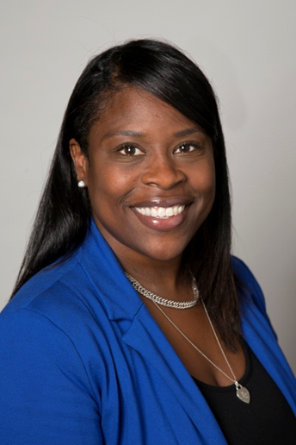
Diana Edwards
Regional Membership
Development
HOW WE WORK TOGETHER
Supervisor,
Regional Membership Development
diana.edwards@rotary.org
+1 (847) 866-3496
Membership growth through strategic planning, membership engagement and retention initiatives, and promoting membership tools and resources.

Slide 6
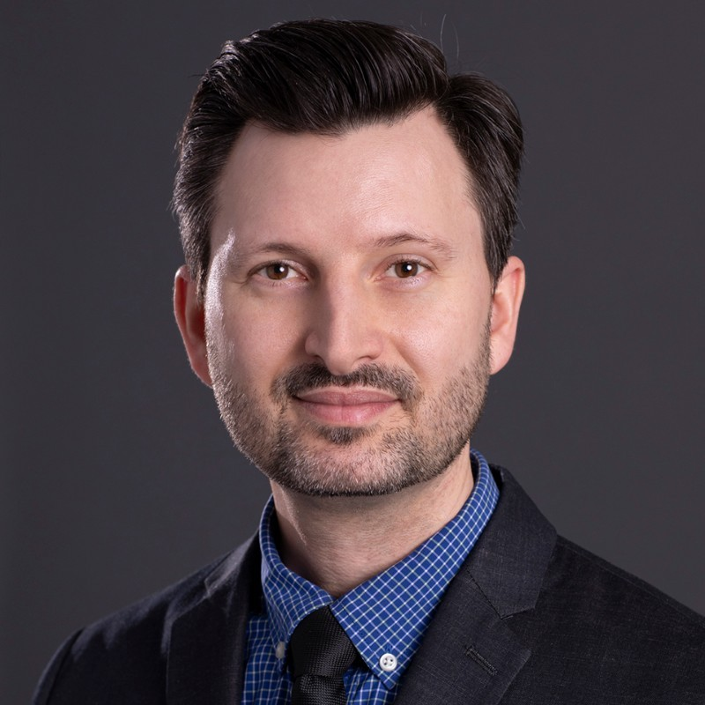
Steven Sundstrom
Grants
Officer
HOW WE WORK TOGETHER
Grant Review
District grant spending plan review, including requests for new spending items, and global grant application review for outgoing scholars and humanitarian or vocational training team applications hosted in your district.
Policy and Procedures
Support in adhering to the Rotary Grants Terms and Conditions and other Grants related policy documents.
Grant Support
Support navigating the Grant Center or accessing materials related to Rotary Grants.
Regional Grants Officer
steven.sundstrom@rotary.org
+1 (847) 424-5230

Slide 7
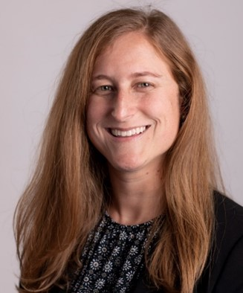
Rebecca Silber
Annual Giving
Officer
HOW WE WORK TOGETHER
Strategies to promote The Rotary Foundation and increase support for the Annual Fund
Fundraising training for district and club leadership
Paul Harris Society promotion
Rotary Direct and online giving
Data and reports training
Club and district presentations
Individual donor cultivation and stewardship
Annual Giving Officer
rebecca.silber@rotary.org
+1 (847) 424-5274

Slide 8

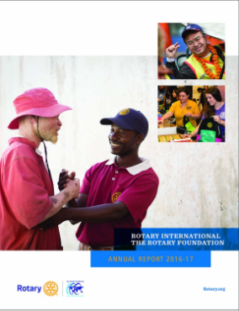
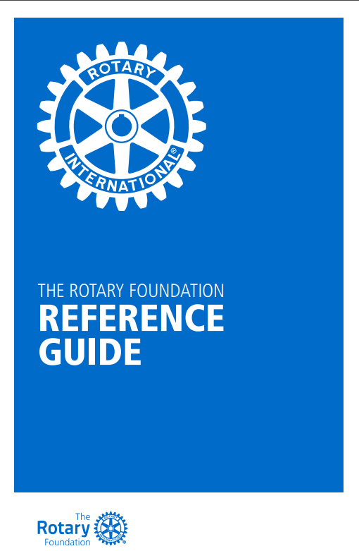
FOUNDATION RESOURCES
Rotary Club Central
  Club and District fundraising reports
Rotary Support Center
  RotarySupportCenter@rotary.org
  +1 (866)-9ROTARY
District Leaders
  District Governors
  District Rotary Foundation Chairs
My.Rotary.org
Notes:
Rotary Club Central houses all available reports analyzing your club or district giving.
The Support Center will provide you with the Club Contribution Report and can assist in order PHF pins and recognition.
My Rotary is another central clearing house for reports to help leaders better understand club and district giving.

