Slide 1
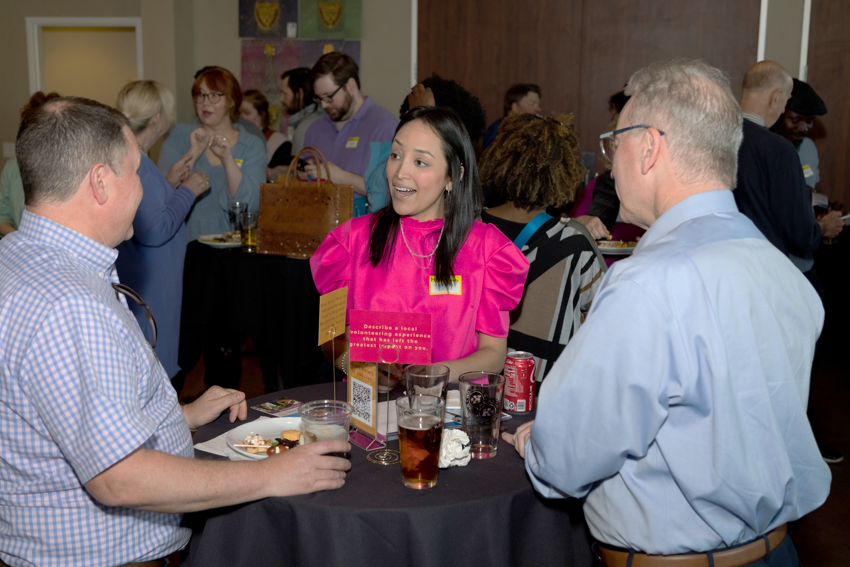
INTENTIONAL LEADERSHIP FOR GROWTH
How Rotary Leaders Ensure Their Clubs Thrive
Notes:
We are pleased to share the results of our survey of successful clubs in the United States and Canada.
As you will see, these clubs have some powerful lessons about how Rotary leaders can focus, and help Rotary grow.

Slide 2
WHY GROW MEMBERSHIP?
We are a membership organization
If you get membership right, the rest falls into place
New members = Greater impact
Notes:
DOUG

Slide 3
Creating a culture of consistent, moderate membership growth
Notes:
LOUISA TO DOUG: We're talking about data as a tool and I'm curious—why is that important in an organization like ours?
DOUG: "If you can do it, you can measure it!" "If I can't measure it, does that mean I'm not doing it?"
Data is the tool we can use to guide us.
Transition to Terry: "We can use attrition and attraction data to transform Rotary. Terry can you help us understand the important terminology?"

Slide 4
ATTRITION AND ATTRACTION:
ATTRITION
RATE
A RATE OF LOSS
% of members who leave our club in an average year
Best in Class (USA): 8-10%
ATTRACTION
RATE
A RATE OF GAIN
% of members admitted to our club in an average year
Notes:
QUESTION FOR TERRY: Help us understand these terms as you mentioned at the

Slide 5
Unless something changes,
Growing clubs continue to grow year after year (80%+ likelihood)
Declining clubs continue to decline year after year (80%+ likelihood)
Clubs “holding their own” can go either way (fragile balance)
Membership realities & goal setting
Analyzed 6 years of membership trends from 16 Districts and 846 Rotary clubs
The likelihood of membership growth in a given year is NOT RANDOM

Slide 6
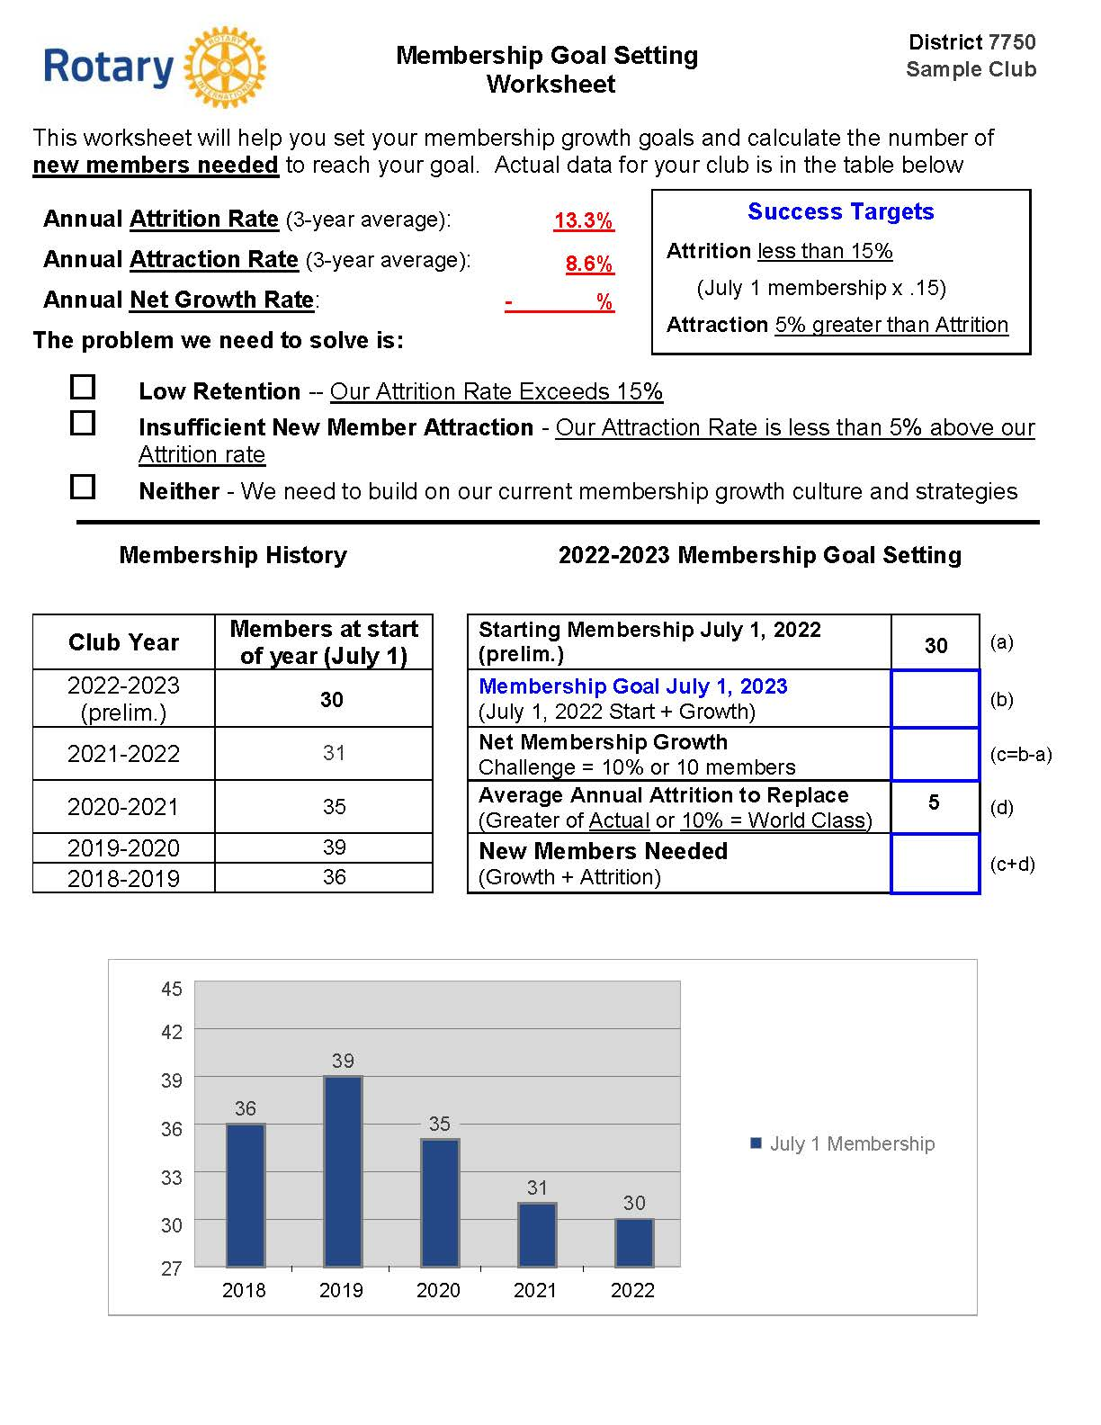

Slide 7
Common club patterns
Key
Growth Culture
High
(>15%)
Growing Membership
Steady Membership
Attraction Rate (%)
Declining Membership
Low
(<10%)
Low
(<10%)
High
(>18%)
Attrition Rate (%)

Slide 8
Common club patterns
Key
Growth Culture
High
(>15%)
Growing Membership
Steady Membership
Attraction Rate (%)
Declining Membership
Danger Zone
Low
(<10%)
Low
(<10%)
High
(>18%)
Attrition Rate (%)

Slide 9
Common club patterns
Key
Growth Culture
High
(>15%)
Growing Membership
Steady Membership
Attraction Rate (%)
Declining Membership
Aging Out
Danger Zone
Low
(<10%)
Low
(<10%)
High
(>18%)
Attrition Rate (%)

Slide 10
Common club patterns
Key
Growth Culture
High Turnover
High
(>15%)
Growing Membership
Steady Membership
Attraction Rate (%)
Declining Membership
Aging Out
Danger Zone
Low
(<10%)
Low
(<10%)
High
(>18%)
Attrition Rate (%)

Slide 11
Common club patterns
Key
Growth Culture
Growth Culture
High Turnover
High
(>15%)
Growing Membership
Steady Membership
Fragile Balance
Attraction Rate (%)
??
Declining Membership
Danger Zone
Aging Out
Danger Zone
Low
(<10%)
Low
(<10%)
High
(>18%)
Attrition Rate (%)

Slide 12
ESSENTIAL LESSONS
Attrition is Real North American Average = 15% “Best-in-Class” (USA) = 8%-10%
Clubs with already-low Attrition Rates can’t improve much by working harder on retention
Attrition Rates > 15% need attention
Notes:
TERRY:
CUE FOR LEE ANN: here’s a sneak preview of what that information will look like

Slide 13
ESSENTIAL LESSONS
Retention is over-rated as a GROWTH strategy
Attraction Rate must exceed Attrition Rate
Need to know your club’s history
Notes:
TERRY:
CUE FOR LEE ANN: here’s a sneak preview of what that information will look like

Slide 15
4.7
X

Slide 16
33
3
Challenge = 5% or 5 members
8
How did we get here?
65 Members in 2004
42
2 Members/Year
2017

Slide 17
SIMPLE SUCCESS TARGETS
Maintain an Attrition Rate below 15%
= July 1 Membership x .15
Maintain an Attraction Rate 5% above Attrition Rate = July 1 Membership x .20
Notes:
HERB

Slide 18
SURVEY (2022)
ROTARY CLUBS IN USA & CANADA
CRITERIA:
10+ Net Members in 5 years
Growth in at Least 3 of the Past 5 Years
Club Sizes Ranged from 7 to 120
(Roughly Equally distributed)
85 clubs that showed consistent growth between 2017-2022
Notes:
Led by the Zones 28 and 32 Analytics Team, this survey was designed to follow up on the 2021 survey completed on clubs in Zones 28 and 32 that grew during the pandemic. In this study we focussed on clubs that had demonstrated successful, long term growth. With the support and collaboration of USA 7 Canada Rotary Co-Ordinators, we were able to extend the survey to encompass clubs in the USA and Canada.
This survey confirmed and enriched the first and leave us confident in the validity of the key drivers of club growth.

Slide 19
CLUB ATTRITION AND ATTRACTION
Average Attrition
North American Clubs 15%
Surveyed Clubs 12%
Average Attraction
North American Clubs 12%
Surveyed Clubs 23%
Notes:
Attrition is the average annual rate at which a club loses members.
Attraction is the average annual rate at which a club gains members.
One way to measure club health is to compare the club’s rates of attrition and attraction. Thanks to the excellent work of Zone 33 Rotary Coordinator Terry Weaver, we were able to compare the attrition and attraction of each club that responded to the survey.
In general, healthy clubs will have an attrition rate of less than 15% and an attraction rate greater than that. As can be seen, the significant majority of clubs in this survey achieved this standard.

Slide 20
ATTRIBUTES OF GROWING CLUBS
ACTIVE, INTENTIONAL MEMBER ENGAGEMENT
DYNAMIC, MEANINGFUL SERVICE
EFFECTIVE GOVERNANCE (Intentional Leadership)
STRONG PUBLIC IMAGE
(WELL KNOWN IN COMMUNITY)
DIVERSITY, EQUITY & INCLUSION
Notes:
With the data from the first survey as a key basis for inquiry, we were able to seek more detail, with the result that our understanding of the qualities that make clubs successful was enhanced, clarified and expanded:
First, and most importantly, we see that leadership is more than an attribute for success – it is an essential, over arching requirement. Strong leaders create strong clubs. More than this, leaders of clubs focused on 5 key areas, which we will explore in more detail:
Outstanding governance – clubs are well organized, plan, set goals and have continuity in leadership.
Active, intentional member engagement – A healthy, engaged and inspired membership is key to club success.
Dynamic, meaningful service – engaged members keep busy ‘doing’ throughout the year. Rotary is about service.
Strong public image – Clubs aren’t just doing – they’re seen to be doing.
Diversity, Equity and Inclusion – ensuring club membership reflects their community
While not all leaders focussed equally on all 5 areas, most clubs take all these areas seriously.

Slide 21
EFFECTIVE GOVERNANCE
PLANNING PROCESS FOR GROWTH
LEADERSHIP CONTINUITY
MEMBERSHIP TOP PRIORITY
Notes:
Effective governance is highlighted in these clubs by three key elements.

Slide 22
MEMBERSHIP TOP PRIORITY
Membership growth top of mind
Membership is everyone’s responsibility
Weekly agenda item
Notes:
These clubs also have an intentional focus on membership. Leaders keep membership at the top of everyone’s mind. Indeed, most often it was an item for discussion at each club meeting.
I want to introduce you to Donna Boyles whose club grew from 21 to 35 during the period of the study. Listen to how she used her imagination and leadership skills to bring her club together in growth. The approach she’s taken is an excellent starting point for leaders of smaller clubs.

Slide 23
LEADERSHIP
What about small clubs?
Notes:
We are often asked the question: We are a small club, what should we focus on to grow? We have limited resources and we can’t focus on all these attributes. The first step is to understand your club’s assets that would be attractive to people in your community with a heart for service. Perhaps it’s the service projects you do or maybe youth programs or something else? Next step might be to have a public image campaign to promote these key assets. Another idea is presented in the next video: Have everyone in your club be part of the membership committee: retention, attraction and innovation. Let’s hear from Donna Boyles on how the King, North Carolina doubled in size using this approach.

Slide 24
ACTIVE, INTENTIONAL ENGAGEMENT
GREAT MEETINGS & STRONG FRIENDSHIPS #1
CONSISTENT & FLEXIBLE MEETINGS
ENGAGING NEW MEMBERS
SAYING “THANK YOU”
Notes:
One of the presidents from our 2021 study said, “Nobody wants to come to a dull meeting.” This study confirms the important role meetings play in ensuring engaged membership. But these clubs have meetings with a purpose, to strengthen their relationships, to learn together and to engage with each other in service.
Meetings are consistent, yet flexible.
Clubs have a process for engaging, supporting and ‘onboarding’ new members.
And they understand the importance of saying thanks.

Slide 25
CONSISTENT & FLEXIBLE MEETINGS
76%
Meet weekly in person
65%
Use hybrid or virtual technology
29%
Created a satellite club as an alternative Rotary experience
Notes:
These clubs meet regularly and are flexible in their approach. Nearly 30% of these growth clubs have created a satellite club as an alternate experience for prospective Rotarians

Slide 26
DYNAMIC, MEANINGFUL SERVICE
“SIGNATURE” PROJECTS & FUNDRAISERS
INCLUDING COMMUNITY MEMBERS
ONGOING, ACTIVE SERVICE
Notes:
Successful clubs make ‘service’ a dynamic center of their activities. They are actively engaged in projects and fundraisers and make it a priority to include community members in those activities. More importantly, and as will be seen, they make service an ongoing, year round priority.

Slide 27
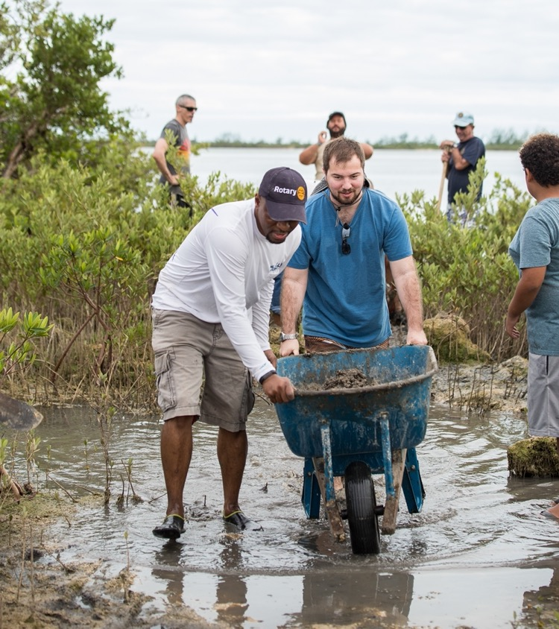
INCLUDE COMMUNITY MEMBERS
“The Secret Sauce”
87%
Invite community members to projects and fundraisers
Quote from survey
“This is the secret sauce.”
67%
Hold one or more events to attract new members
Notes:
We can’t emphasize strongly enough how important the act of reaching out to the broader community is to creating the perception of a dynamic, attractive and welcoming group of people. As we quote from the survey. It really is the secret sauce, creating opportunities to engage and inspire ‘not yet Rotarians’.

Slide 28
STRONG PUBLIC IMAGE
ACTIVE USE OF MEDIA TOOLS
A FOCUS ON MEMBER ATTRACTION
It’s not just doing, it’s being seen doing!
Notes:
Public Image also has played a key role in club growth. It’s not just doing, it’s being seen doing.

Slide 29
ACTIVE USE OF MEDIA TOOLS
95%
Use Facebook
21%
Use Instagram
77%
Use Their Club Website
55%
Use Local Print News Outlets

Slide 30
DIVERSITY, EQUITY, INCLUSION
AN INTENTIONAL FOCUS
CLUB REFLECTS THE COMMUNITY
A WELCOMING ENVIRONMENT
Notes:
During interviews with club leaders, it became clear how important a contributor increasing club diversity was to club growth.
Club leaders were intentional in increasing their club’s diversity, recognizing, for example, that younger members we necessary to ensure the club’s long term viability; that they needed to broaden the professions represented in their club; or acting to reduce costs to make membership more appealing.
They also worked to make sure their membership reflected their community and finally, perhaps most importantly, acted to create an environment where everyone felt genuinely welcomed.
I want to let another leader conclude this presentation. Mary Anne Velayo is from the Vancouver Mountainview club, a club that grew from 18 to 52 during the period of this study. Let’s listen to her view of Rotary leadership.

Slide 31
ATTRIBUTES OF GROWING CLUBS
ACTIVE, INTENTIONAL MEMBER ENGAGEMENT
DYNAMIC, MEANINGFUL SERVICE
EFFECTIVE GOVERNANCE (Intentional Leadership)
STRONG PUBLIC IMAGE
(WELL KNOWN IN COMMUNITY)
DIVERSITY, EQUITY & INCLUSION
Notes:
With the data from the first survey as a key basis for inquiry, we were able to seek more detail, with the result that our understanding of the qualities that make clubs successful was enhanced, clarified and expanded:
First, and most importantly, we see that leadership is more than an attribute for success – it is an essential, over arching requirement. Strong leaders create strong clubs. More than this, leaders of clubs focused on 5 key areas, which we will explore in more detail:
Outstanding governance – clubs are well organized, plan, set goals and have continuity in leadership.
Active, intentional member engagement – A healthy, engaged and inspired membership is key to club success.
Dynamic, meaningful service – engaged members keep busy ‘doing’ throughout the year. Rotary is about service.
Strong public image – Clubs aren’t just doing – they’re seen to be doing.
Diversity, Equity and Inclusion – ensuring club membership reflects their community
While not all leaders focussed equally on all 5 areas, most clubs take all these areas seriously.

Slide 32
THANK YOU!
Herb Klotz
herbk.rotary@gmail.com

